Slide 1
Dopamine enhances model-based over model-free choice behavior
Peter Smittenaar*, Klaus Wunderlich*, Ray Dolan

Slide 2
Model-based and model-free systems
model-free (habitual)
Cached values: single stored value
Learned over many repetitions
TD prediction error
Inflexible, but computationally cheap
model-based (goal-directed)
Model of environment with states and rewards
Forward model computes best action ‘on-the-fly’
Flexible, but computationally costly
Behavior is a combination of these two systems (Daw et al., 2011)

Slide 3
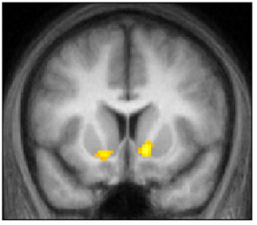
Two systems interact
How do these two systems interact to generate behavior?
Compete at output / collaborate during learning? (Daw et al., 2005; Doll et al., 2009; Biele et al., 2011)
Both systems use overlapping neural systems. (Daw et al., 2011; Wunderlich et al., 2012)
What is the role of dopamine in model-based/model-free interactions?
How does L-DOPA affect control exerted by either system?
conjunction: model-based & model-free
Daw et al., 2011

Slide 4
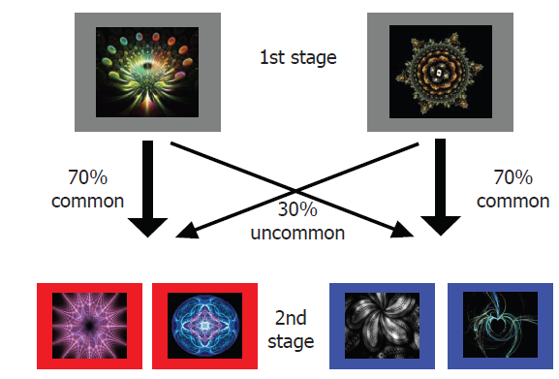
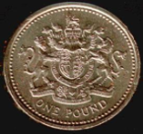
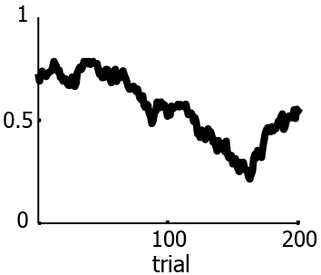
2-step task
X
based on Daw et al., 2011

Slide 5
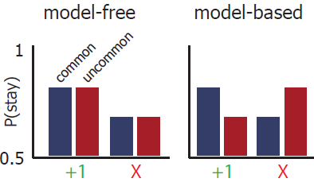
p(stay) dissociates two systems

Slide 6
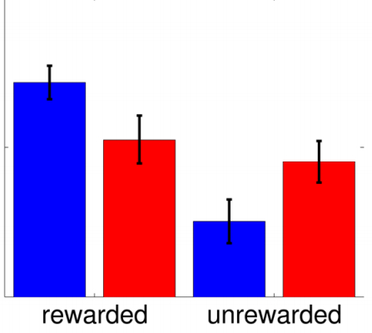
choices show both systems have control
Daw et al., 2011

Slide 7
choices show both systems have control
Daw et al., 2011

Slide 8
choices show both systems have control
Choice is a mix of model-free
and model-based control
18 subjects on and off L-DOPA
within-subject design
Daw et al., 2011

Slide 9
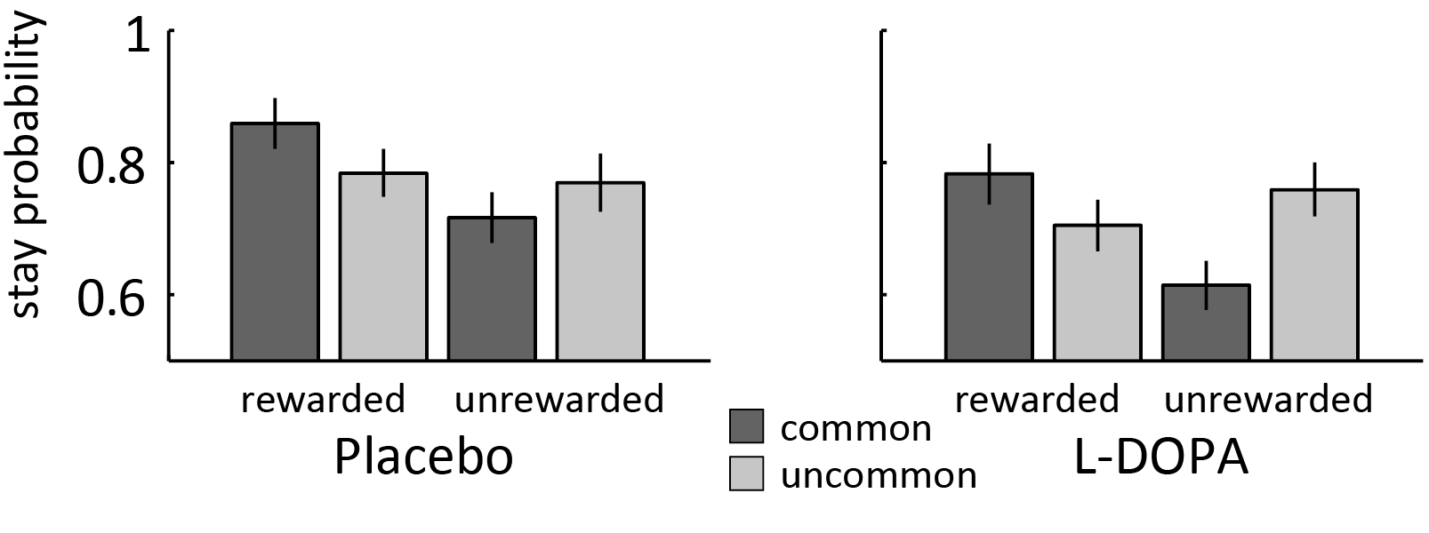
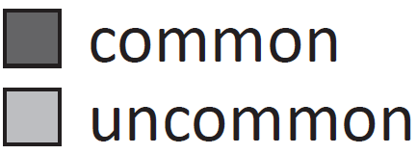
choices show both systems have control
Choice is a mix of model-free
and model-based control
Daw et al., 2011

Slide 10
L-DOPA enhances model-based control
L-DOPA increases model-based, but not model-free behavior

Slide 11
Parameter w weights MB and MF influence
1
2
V₁: value stimulus 1
w: weighting parameter
α: model-free learning rate
λ: eligibility gain
r: reward on trial t
Hybrid
${V^{hybrid}}_{1} = w∗{V_{1}}_{}^{MB} + \left(1−w\right)∗{V_{1}}_{}^{MF}$
Model-free
${V^{MF}}_{1,\left(t+1\right)} = V_{1,t} + α\left(V_{s2_{chosen}}− V_{1,t}\right) + λα (r−V_{1,t})$
Model-based
${V^{MB}}_{1} = 0.7 ∗\max\left(V_{3},V_{4}\right) + 0.3 ∗max⁡(V_{5},V_{6})$

Slide 12
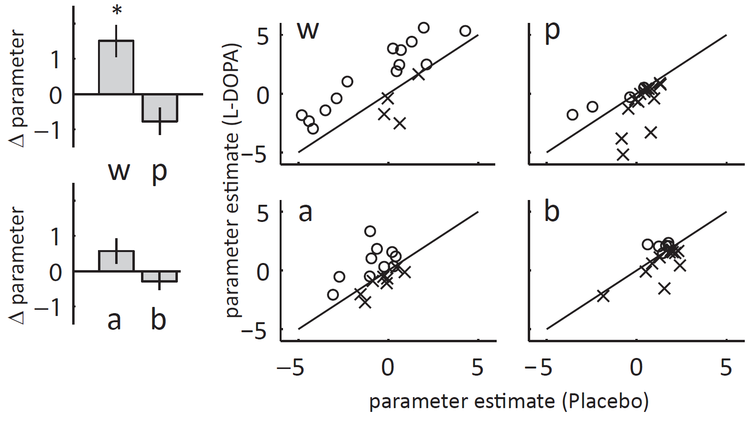
L-DOPA increases model-based control (w)
* p = .005

Slide 13
L-DOPA does not affect model-free system
L-DOPA enhances model-based over model-free control
No effect on model-free:
learning rate
noise
policy / value updating
positive / negative prediction errors

Slide 14
Conclusion
L-DOPA enhances model-based over model-free control
No effect on model-free:
learning rate
noise
policy / value updating
positive / negative prediction errors
L-DOPA might
improve components of model-based system
directly alter interaction between both systems at learning or choice (Doll et al., 2009)

Slide 15
Effect stronger after unrewarded trials
L-DOPA minus placebo

Slide 16
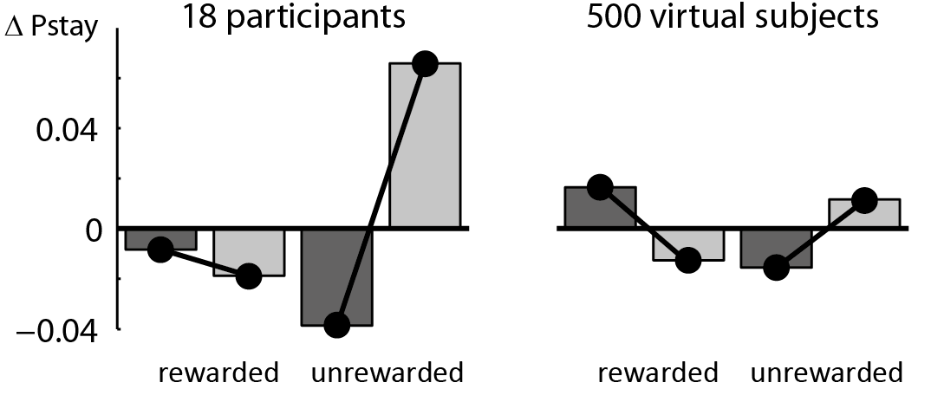
Effect stronger after unrewarded trials
L-DOPA minus placebo
Increase in model-based control particularly strong after unrewarded trials

Slide 17
Conclusion
L-DOPA enhances model-based over model-free behavior
L-DOPA might
improve components of model-based system
directly alter interaction between both systems at learning or choice (Doll et al., 2009)
facilitate switching to model-based control when needed (Isoda and Hikosaka, 2011)

Slide 18
Acknowledgements
Klaus Wunderlich
Tamara Shiner
Ray Dolan
The Einstein meeting’s organizers

Slide 19
Thank you

Slide 20
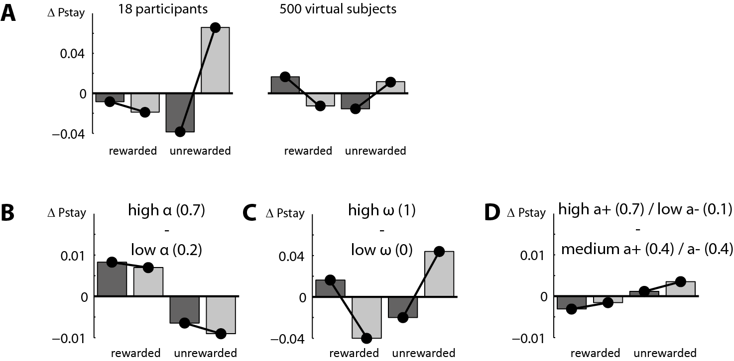

Slide 21
Alternative models
‘Random effects’ Bayesian model comparison
Alternative model to a, b, p, w | Placebo |  | L-DOPA
 | Better in #subjects | Exceedance probability | Better in #subjects | Exceedance probability
a1, a2, b1, b2, l, p, w | 17 | >0.999 | 15 | 0.999
a1, a2, b1, b2, p, w | 14 | 0.997 | 15 | 0.999
a, b1, b2, p, w | 13 | 0.970 | 14 | 0.998
a1, a2, b, p, w | 15 | >0.999 | 15 | >0.999
a+, a-, b, p, w | 12 | >.831 | 15 | >.996
a, b, l, p, w | 16 | >0.999 | 17 | >0.999
a, b, w | 16 | >0.999 | 12 | 0.944
a, b | 16 | >0.999 | 12 | 0.911
MF/MB learning rates | 16 | 0.999 | 14 | 0.999
Actor/critic learning | 18 | >0.999 | 17 | >0.999
MB prediction errors | 12 | >0.999 | 13 | 0.998

Slide 22
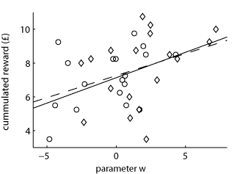

Slide 23
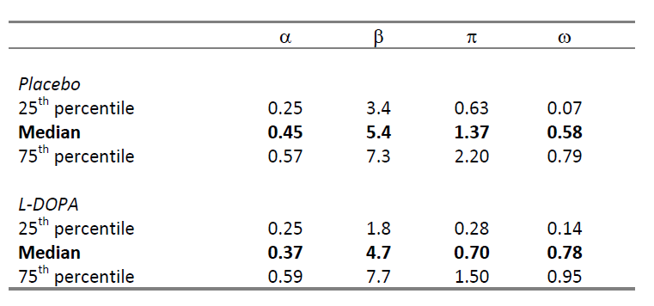
Notes:
inverse temperature: higher is more accurate.

